Slide 1
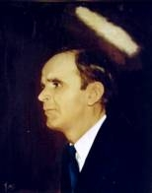

108
JESUS SET ME FREE
I’m so glad Jesus set me free,
I’m so glad Jesus set me free,
I’m so glad Jesus set me free,
Glory, hallelujah, Jesus set me free.
(I’m so glad Jesus lifted me…)
(I’m on my way to Heaven, shouting victory...)
(Satan had me bound, but Jesus set me free...)

